Slide 1
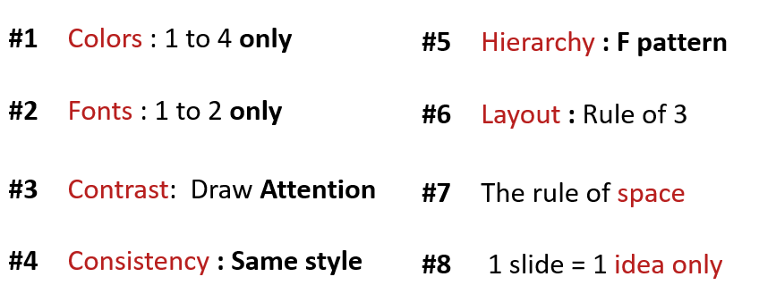
ACTIVITY 2
Analyze the problems on the slides
What is not useful ?
Which rule is not valid?
Improve the slides to fix the problem

Slide 2
Quiz-app G-7
MSK
AGENDA
1. THE SELLER
KEA NHOR
2. THE TECH
SOPHAL SARARN
3. THE MANAGER
MENG MAO

Slide 3

Quiz-app G-7
The Manager
MSK
3 What your team need to improve?
Improve communication & time management
Improve researching skills & responsibility
Improve discussing & solidarity

Slide 4
What is not useful?
The thing that not useful in this slide such as:
Look messy
It’s is not good slide
Don’t have where to look
Not interesting
Which rule is not valid?
The rule that is not valid such as:
Color: Use more than 4 colors
Fonts: Use font more than 2 and it doesn’t in the same group
Contrast: Not contrast on this slide

